Slide 1
Cardiovascular Disease Ukraine
Eric Rizzio, Chris White, Abbie Hockstad, Kelsey Ness

Slide 2
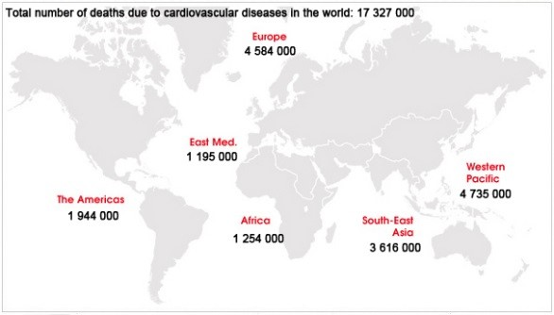
Global Overview
According to the American Heart Association, “cardiovascular disease refers to any disease that affects the cardiovascular system, principally cardiac disease, vascular diseases of the brain and kidney’s and peripheral arterial disease.
The number one killer across the globe since the 1970s has been cardiovascular diseases.
The World Health Organization claims: (WHO, 2008)
•An estimated 17.3 million people died from CVDs in 2008.
•Over 80% of CVD deaths take place in
low- and middle-income countries.
•By 2030 more than 23 million people will die annually from CVDs.

Slide 3
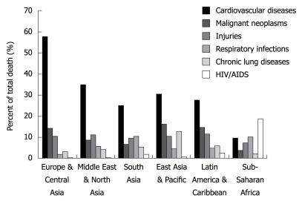
Global Overview
This chart shows that CVD is the number one cause of death in all regions except for sub-Saharan Africa; however when the analysis extends beyond adults aged 30 years and older, CVD is number one cause of death in all regions.
(NCBI, 2009).

Slide 4

Risk Factors
Misconceptions:
  Wealthy
  Industrialized Societies
Truth:
  High number of infectious diseases cases, and have taken precedent over this epidemic.
  No policy fits every situation
  Hypertension
  Smoking
  Obesity (due to poor diet and/ lack of physical activity)
  Hyperlipidemia
  Genetic predisposition
  (Miller, 2009)
(Digital Health Technology 2013)

Slide 5
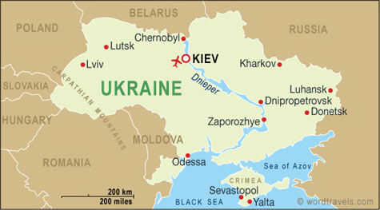
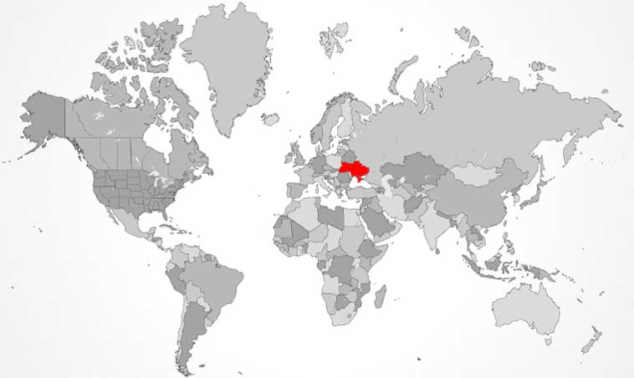
Overview in Ukraine
(Russia Ukraine Travel 2005)
(Russia Ukraine Travel 2005)
2.4 million new cases registered annually.
450,000 deaths annually
35,000 need surgery/6,000 receive it.
Kills 130 working age adults each day.
Causes loss of human and economical potential.
(Rudnieva, 2003)

Slide 6

Environmental Aspect
Nearly 1/3 of the population live in rural areas.
Some areas as low as 30-70 people per km^2.
Limits the amount of doctors and nurses available
Expenses high/ Income low
One Doctor is responsible for 1000-1300 patients over a larger land area.
(Lekhan, Valeria, Rudiy, Nolte, 2004)
(Farmer, 2012)

Slide 7
Political Aspect
Process by which groups make decisions, usually relates to running government or state affairs; consist of social relationships involving authority and power.
Ukraine's health system needs to be re oriented from a short term care input based model to a comprehensive disease management model that is more appropriate for NCD (Non-communicable disease) prevention and control.
A Non-Communicable Disease, or NCD, is a medical condition or disease, which by definition in non-infectious and non-transmissible among people. NCDs may be chronic diseases of long duration and slow progression, or they may result in more rapid death such as some types of sudden stroke.
“Resources For." Europe and Central Asia. N.p., n.d. Web. 29 Apr. 2014.

Slide 8
Political Aspect
In the short term, there is a need to identify and implement priority cost-effective interventions (both within and outside the health system) that target the major risk factors, such as:
    Alcohol and Tobacco
    Road Safety
    Diet/ Physical Activity
Within an integrated strategy for NCD prevention.
Resources For." Europe and Central Asia. N.p., n.d. Web. 29 Apr. 2014.

Slide 9
Political Aspect
Ukraines health system is:
  Complex
  Inefficient
  Highly inequitable
  Low of quality
  Lacks a comprehensive health reform implementation plan

Slide 10
Political Aspect
Unlike Ukraine, all Central European countries underwent comprehensive reforms in their health systems, starting early in the transition process.
Reforms in Central European countries were guided by a series of
    Legislations
    Policies
    Strategic Plans
Which were constantly adapted to changing needs. In all cases, effective government stewardship was critical to ensuring success in implementation of reforms.
An important element of the reforms was defining the roles and responsibilities of the various players in the health systems.
Experience from Central European health reforms suggests that removing rigidities in:
    Resource Allocation
    Emphasizing primary care
    Introducing referral care systems
    Rationalizing excess capacity at secondary and tertiary levels
    Providing performance-based payments to providers should be the focus of the health system reform in Ukraine.

Slide 11
Cultural Aspect
Beliefs, values, behaviors, etc. of a group regarding social learning
Factors:
  Taking care of their health
  Trust
Other:
  Medical Care is uneven
  Doctors may give a wrong diagnosis
  Importance of leading a healthy lifestyle is not known very well
  Not can all afford medical care

Slide 12

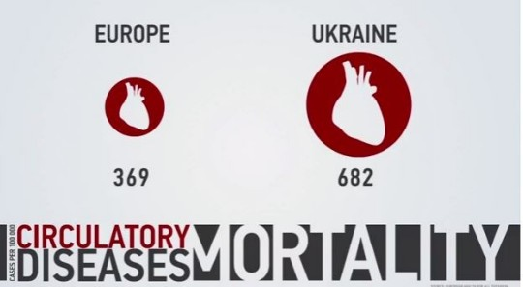
Design Aspect
How the problem is depicted in art, music, literature, video, etc.
http://www.undp.org/content/ukraine/en/home/presscenter/articles/2013/11/28/non-communicable-diseases-in-ukraine/
http://www.ukrainebusiness.com.ua/news/8405.html

Slide 13
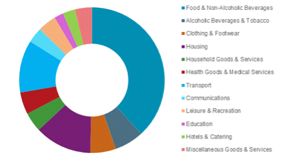
Economic Aspect
Economic aspects of cardiovascular disease in Ukraine refers to the costs/ benefits, employment, fiscal policy, production, distribution, and consumption of goods and services all related to the problem of CVD in Ukraine. They are the aspects of the economy that affect the problem.
The income and spending of Ukrainian households took a sharp decline in 2009 (disposable income: $39,000, consumer expenditure: $35,000) as their country was hit by global economic crisis in 2008-2009 (Hodgson, 2012)
Ukrainian households still remain the poorest in Europe, devoting all of their expenditure to household essentials (Hodgson, 2012).
Cardiovascular Disease is seen to be on the rise in countries like Ukraine where out-of-pocket payments are high in regards to medical treatment.
In 2009, 16.1% of the population did not earn a living wage and 14.4% of the population live below the national poverty line (Murphy et al., 2013.)
40.5% of Ukrainians pay for medical treatment out of pocket
Photo (Hodgson, 2012).

Slide 14
Economic Aspect
All Ukranians are entitled to a guaranteed package of health care services provided free of charge at the point of use; however, resource constraints have led to attempts by the government to limit the range of services covered in this package (Murphy et al., 2013).
Outpatient drugs are not included
Households of ischemic heart disease (a type of CVD) patients in Ukraine are more likely to engage in distress financing to cover the cost of treatment, and a high proportion of patients do not acquire prescribed medicines because they cannot afford them.
Not purchasing the medications ultimately results in hospitalization and death, a huge reason why CVD is a big problem in Ukraine.
The stress over finances also can lead to smoking and drinking, two big risk factors of CVD.

Slide 15
Historical Aspect
Historical aspects of cardiovascular disease refers to how the history of the people in Ukraine affect the problem of cardiovascular disease. History alludes to the story of something through time; how the past affects the present.
Ukraine has a high death rate of 16.3 deaths/1,000 population (Health in Ukraine, 2014).
According to the 2010 World Bank study, 36% (28.6% is the average in Europe) of Ukrainians smoke tobacco, including 31% of those who smoke everyday.
Today, cigarettes can be found on almost every street corner even in the poorest countries like Ukraine and cost almost next to nothing (What’s on Kyiv, 2013).
According to the newspaper “What’s on Kyiv”, smoking is known as one of the few things that actually brings Ukrainians from all backgrounds together.
Two main factors: smoking and alcohol abuse
Smoking has been a way of socializing for the people of Ukraine.
As we can see from contemporary paintings, the Cossacks were never seen without their saber, bandora and pipe.
Cossacks= group of predominantly East Slavic people who became known as members of democratic, semi-military communities, predominantly located in Ukraine and in Southern Russia
Smoking will remain one of Ukraine’s favorite past times

Slide 16
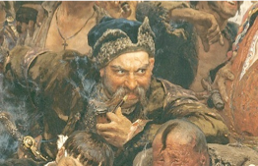

Historical Aspect
Alcohol related deaths: one of the most preventable causes of death in Ukraine
Alcohol consumption in Ukraine goes back to the 15th century where the North West region of contemporary Ukraine (Volyn region) was famous for producing very good Horilka (Alcohol History, 2014).
“Horilka” is the Ukrainian word for “vodka”
Horilka is the drink of Ukraine and that it is served at parties, gatherings, and celebrations (Alcohol History, 2014).
The history of Horilka is something that is held close to the hearts of Ukrainians.
Photos: Cossack (Rohmann, 2013) and Horilka (Stevenstirski.com, 2011).

Slide 17
Health Interventions
Health interventions refers to the programs and/or policies/procedures (paradigms) used to address cardiovascular disease in Ukraine. It also refers to evidence with reliable data that shows the interventions are effective in Ukraine.
Experts of the Amosov Research Institute of Cardiovascular Surgery believe that well over 35,000 patients need heart surgery, including adults and children.
Each year six thousand Ukrainian children are diagnosed with congenital heart disease, while nearly forty thousand children aged under fourteen suffering from heart disorders are registered (Rudnieva, 2003).
Specialized inpatient care is becoming more accessible to rural population, and new effective drugs appear on the market (Rudnieva, 2003).
In regards to heart patients, Ukraine has seen some positive shifts in the medical field.
Preventing CVD is a national priority in Ukraine, which is evidenced by a number of nationwide programs such as the Health of the Nation Program, Arterial Hypertension Prevention and Treatment Program, along with measures to develop heart surgery.
Ukraine is working to increase public awareness of heart disease, encourage preventive treatment, enhance medical services, and upgrade medical equipment.
Registered patients must have least one electrocardiogram and echocardiogram performed once a year, along with blood tests for lipids and sugars (Rudnieva, 2003).

Slide 18
Health Interventions
Director of the Amosov Research Institute of Cardiovascular Surgery and academician of the Ukrainian National Academy of Sciences, says that the levels of heart surgery are being improved by upgrading equipment and increasing the salaries of surgeons and assistants.
Amosov Institute can perform a maximum of five thousand surgeries a year, so plans are being made to expand
The structural divisions should perform simple surgeries, while the institute will do research, introduce new methods, and perform complex surgeries (Rudnieva, 2003)
Director of the Research and Practical Medical Center of Children’s Cardiology and Cardio surgery, explains that the government has made it possible to open a separate Center of Children’s Cardiology and Cardio Surgery.
10 million dollars worth of equipment has been bought for the center, which had its resuscitation unit, diagnostics department, and artificial blood circulation laboratory re equipped (Rudnieva, 2003).
Improved children’s cardio surgeries dramatically

Slide 19
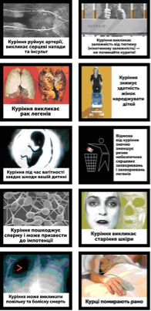
Health Interventions
In October 2012, pictorial warnings appeared on cigarette packs in Ukraine for the first time.
The warnings cover 50% of one side of the pack; the other side has a text warning covering 50% of the pack. Previously, only text warnings covered 30% of both sides (New pictorial warnings, 2012).
The World Heart Federation says about one quarter of all Ukrainian smokers are still unaware that smoking increases their risk of heart disease and stroke.
December 17, 2012, all Ukrainian cafés, bars and restaurants became 100% smoke free.
Chernobyl Children’s project International is also another health intervention that is working to help CVD in Ukraine.
Volunteer surgical teams travel throughout the Ukraine to perform surgeries that save lives, and CCI provides financial and logistical support to the cardiac surgeons in order for them to make the vital trips to the effected areas (Medical Programs).
CCI also trains local physicians and gives them technologically advanced medical equipment.
This training develops local capacity and skills, enabling local surgical teams to treat the children in their own area more effectively and with more success (Medical Programs).

Slide 20
WOW Factor
http://www.chernobyl-international.com/programmes/medical-programmes-projects/cardiac-mission

Slide 21
References
Miller, Michael, and Temilolu Olayinka Aje. "Cardiovascular Disease: A Global Problem Extending into the Developing World." National Center for Biotechnology Information. World Journal of Cardiology, 31 Dec. 2009. Web. 02 Mar. 2014.
"Global Facts & Map." World-heart-federation.org. World Heart Federation, n.d. Web. 27 Feb. 2014.
"Ukraine Maps." Russia Ukraine Travel Information from Independent Guides and Interpreters. Russia-Ukraine-Travel, n.d. Web. 02 Mar. 2014.
"Cut Your Cardiovascular Risk by 45% by Reducing Your A1C by 1%!" Digital Health Technology. Digital Health Technology, 22 Oct. 2013. Web. 26 Mar. 2014.
Rudnieva, Olha. "Heart Disease Kills 450,000 Ukrainians Annually." Heart Disease Kills 450,000 Ukrainians Annually. Day.kiev.ua/, 18 Nov. 2003. Web. 02 Mar. 2014.
Lekhan, Valeria, Volodomyr Rudiy, and Ellen Nolte. "Healthcare Systems inTransition.”Ukraine (2004): 1-138. Euro.who.int. Web. 02 Mar. 2014.
Farmer, Jane. "Health Care in Rural Areas: The Answer Is Not More of The same." The Conversation. N.p., 04 Sept. 2012. Web. 02 Apr. 2014.

